Slide 1









Robust M-Estimation Based SVM
for Improving Binary Classification
이중 분류 성능 향상을 위한 강건한 M-추정 기반 SVM
김민경, 유지아, 윤진희
Min Kyung Kim, Jia You, Jin Hee Yoon
Department of Mathematics and Statistics, Sejong Univ., South Korea
한국지능시스템학회 2025 춘계학술대회

Slide 2

1. Introduction
• Support Vector machines(SVMs) are widely applied in classification problems;
here, we focus on binary classification.
• Key strengths:
- Strong generalization, even with small datasets
- Flexible via kernel functions
- Guarantees global optimum (quadratic programming)
02

Slide 3
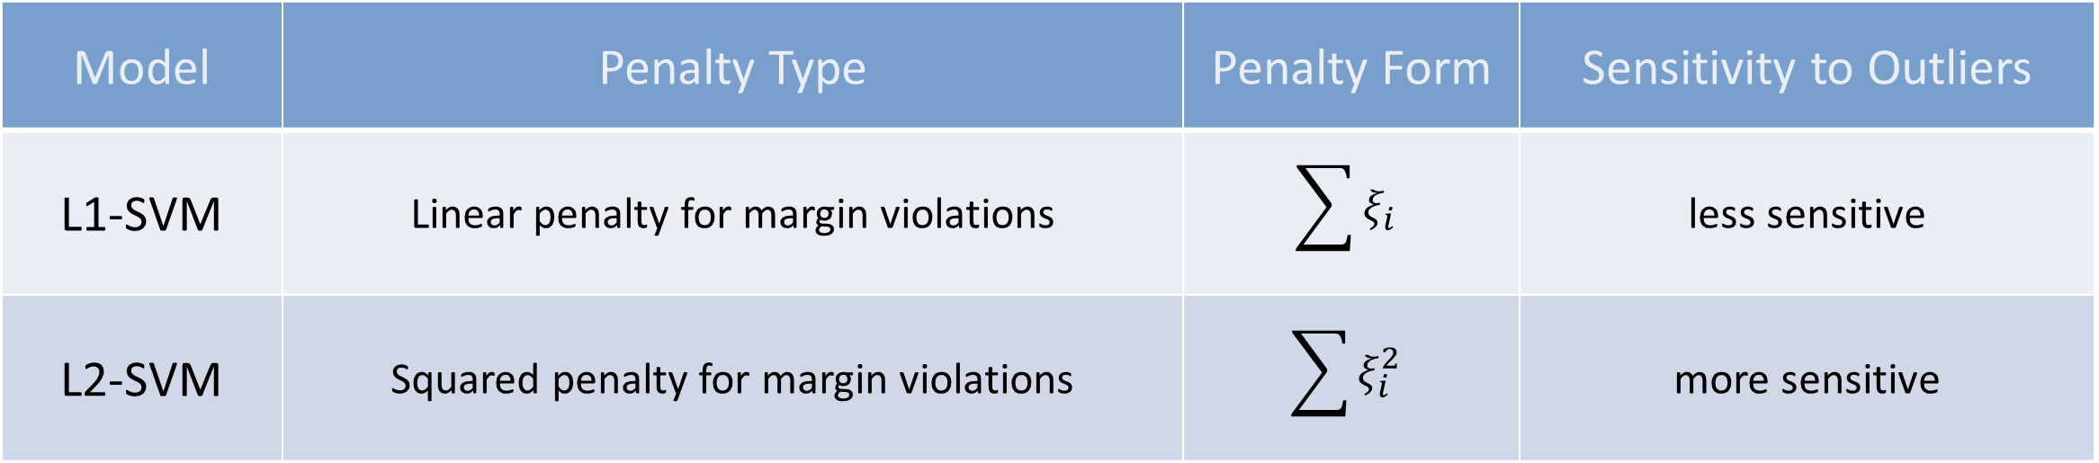
1. Introduction
Model | Penalty Type | Penalty Form | Sensitivity to Outliers
L1-SVM | Linear penalty for margin violations | $$\sum{ξ_{i}}$$ | less sensitive
L2-SVM | Squared penalty for margin violations | $$\sum{ξ_{i}^{2}}$$ | more sensitive
03

Slide 4
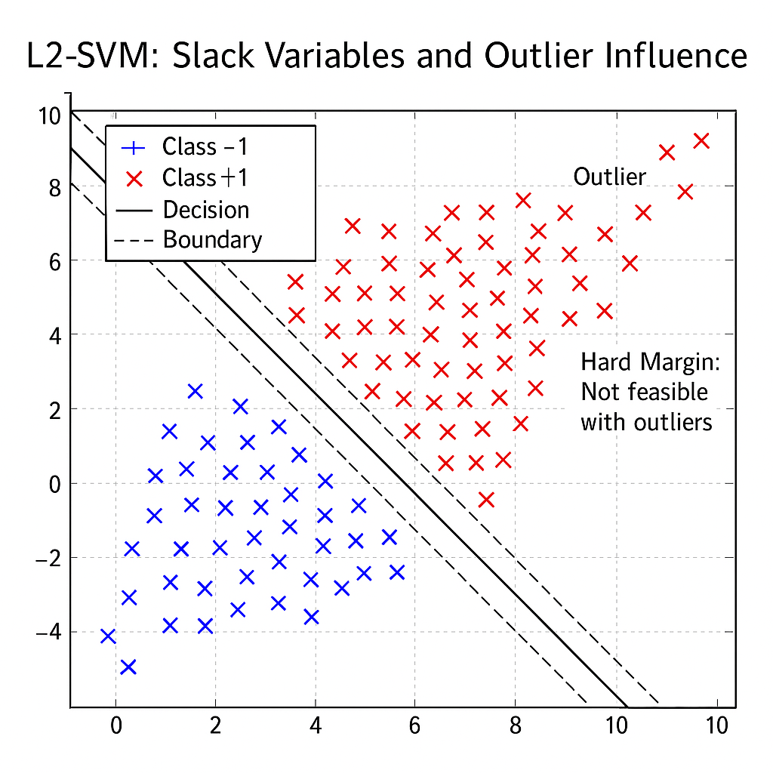
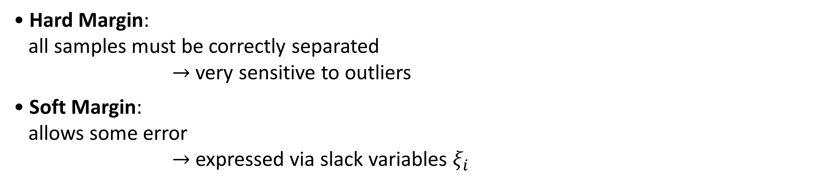
2. Limitations of Traditional SVMs
Hard Margin vs. Soft Margin
• Hard Margin:
all samples must be correctly separated
$→$ very sensitive to outliers
• Soft Margin:
allows some error
$→$ expressed via slack variables $ξ_{i}$
04
Notes:
Hard margin은 모든 점을 완벽히 분리해야 하기 때문에, 이처럼 이상치가 존재할 경우 학습 자체가 불가능해집니다. 따라서 soft margin이 필요하며, 이때 슬랙 변수 ξi\xi_iξi​가 도입됩니다.

Slide 5
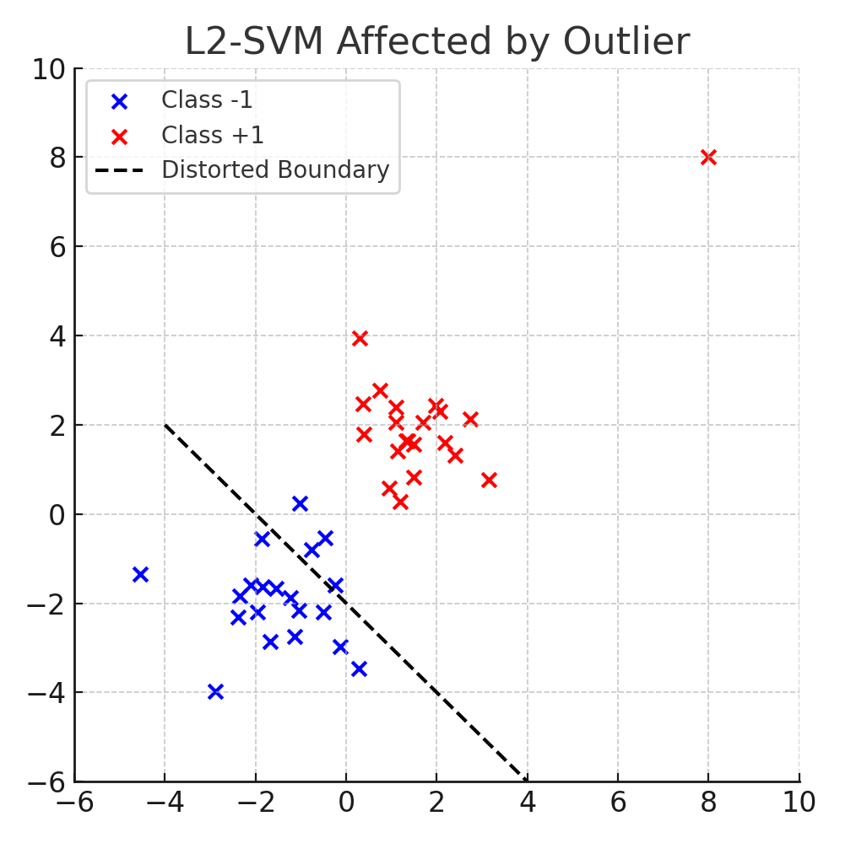
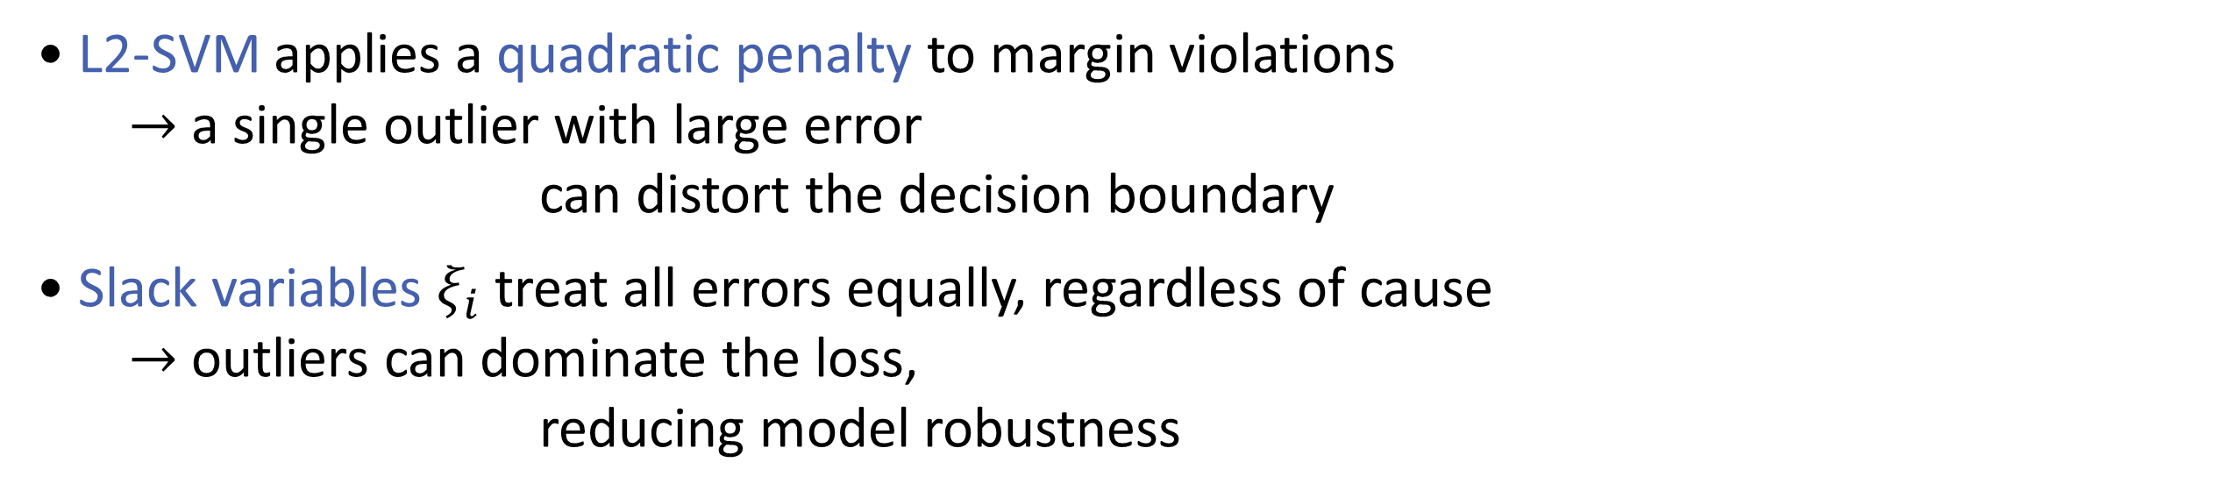
2. Limitations of Traditional SVMs
L2-SVM Limitations
• L2-SVM applies a quadratic penalty to margin violations
$→$ a single outlier with large error
can distort the decision boundary
• Slack variables $ξ_{i}$ treat all errors equally, regardless of cause
$→$ outliers can dominate the loss,
reducing model robustness
05
Notes:
이 그래프는 L2-SVM이 이상치 하나에 의해 결정 경계가 크게 왜곡되는 예를 보여줍니다. 이는 L2-SVM이 슬랙 변수를 제곱하여 패널티를 주기 때문에 발생하는 문제입니다.”

Slide 6
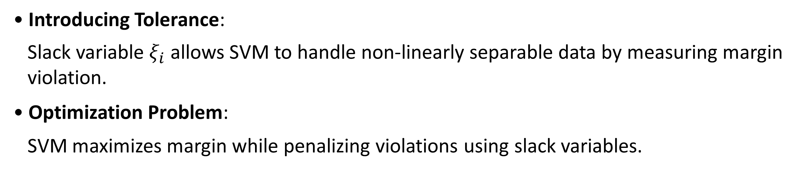
2. Limitations of Traditional SVMs
Role of Slack Variables $ξ_{i}$
• Introducing Tolerance:
Slack variable $ξ_{i}$ allows SVM to handle non-linearly separable data by measuring margin
violation.
• Optimization Problem:
SVM maximizes margin while penalizing violations using slack variables.
06

Slide 7
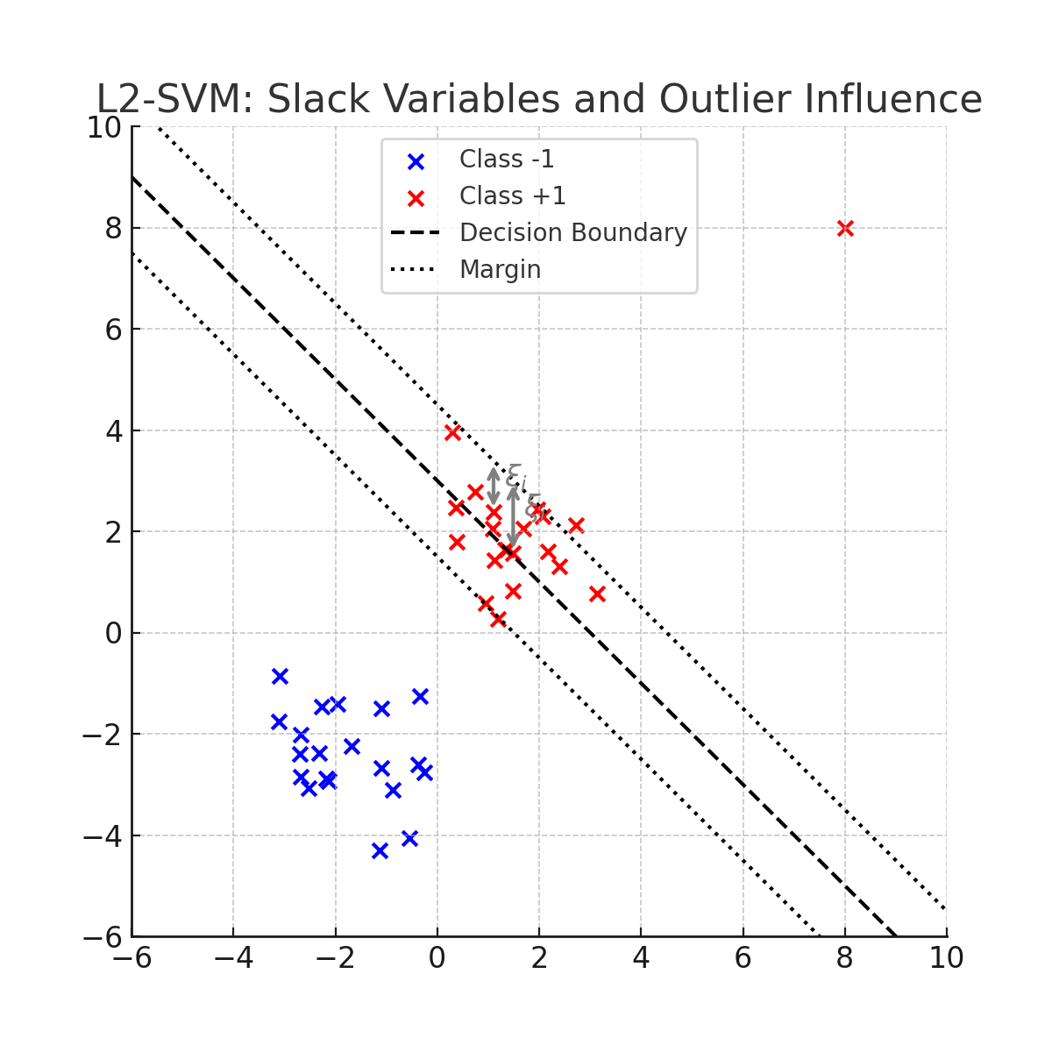
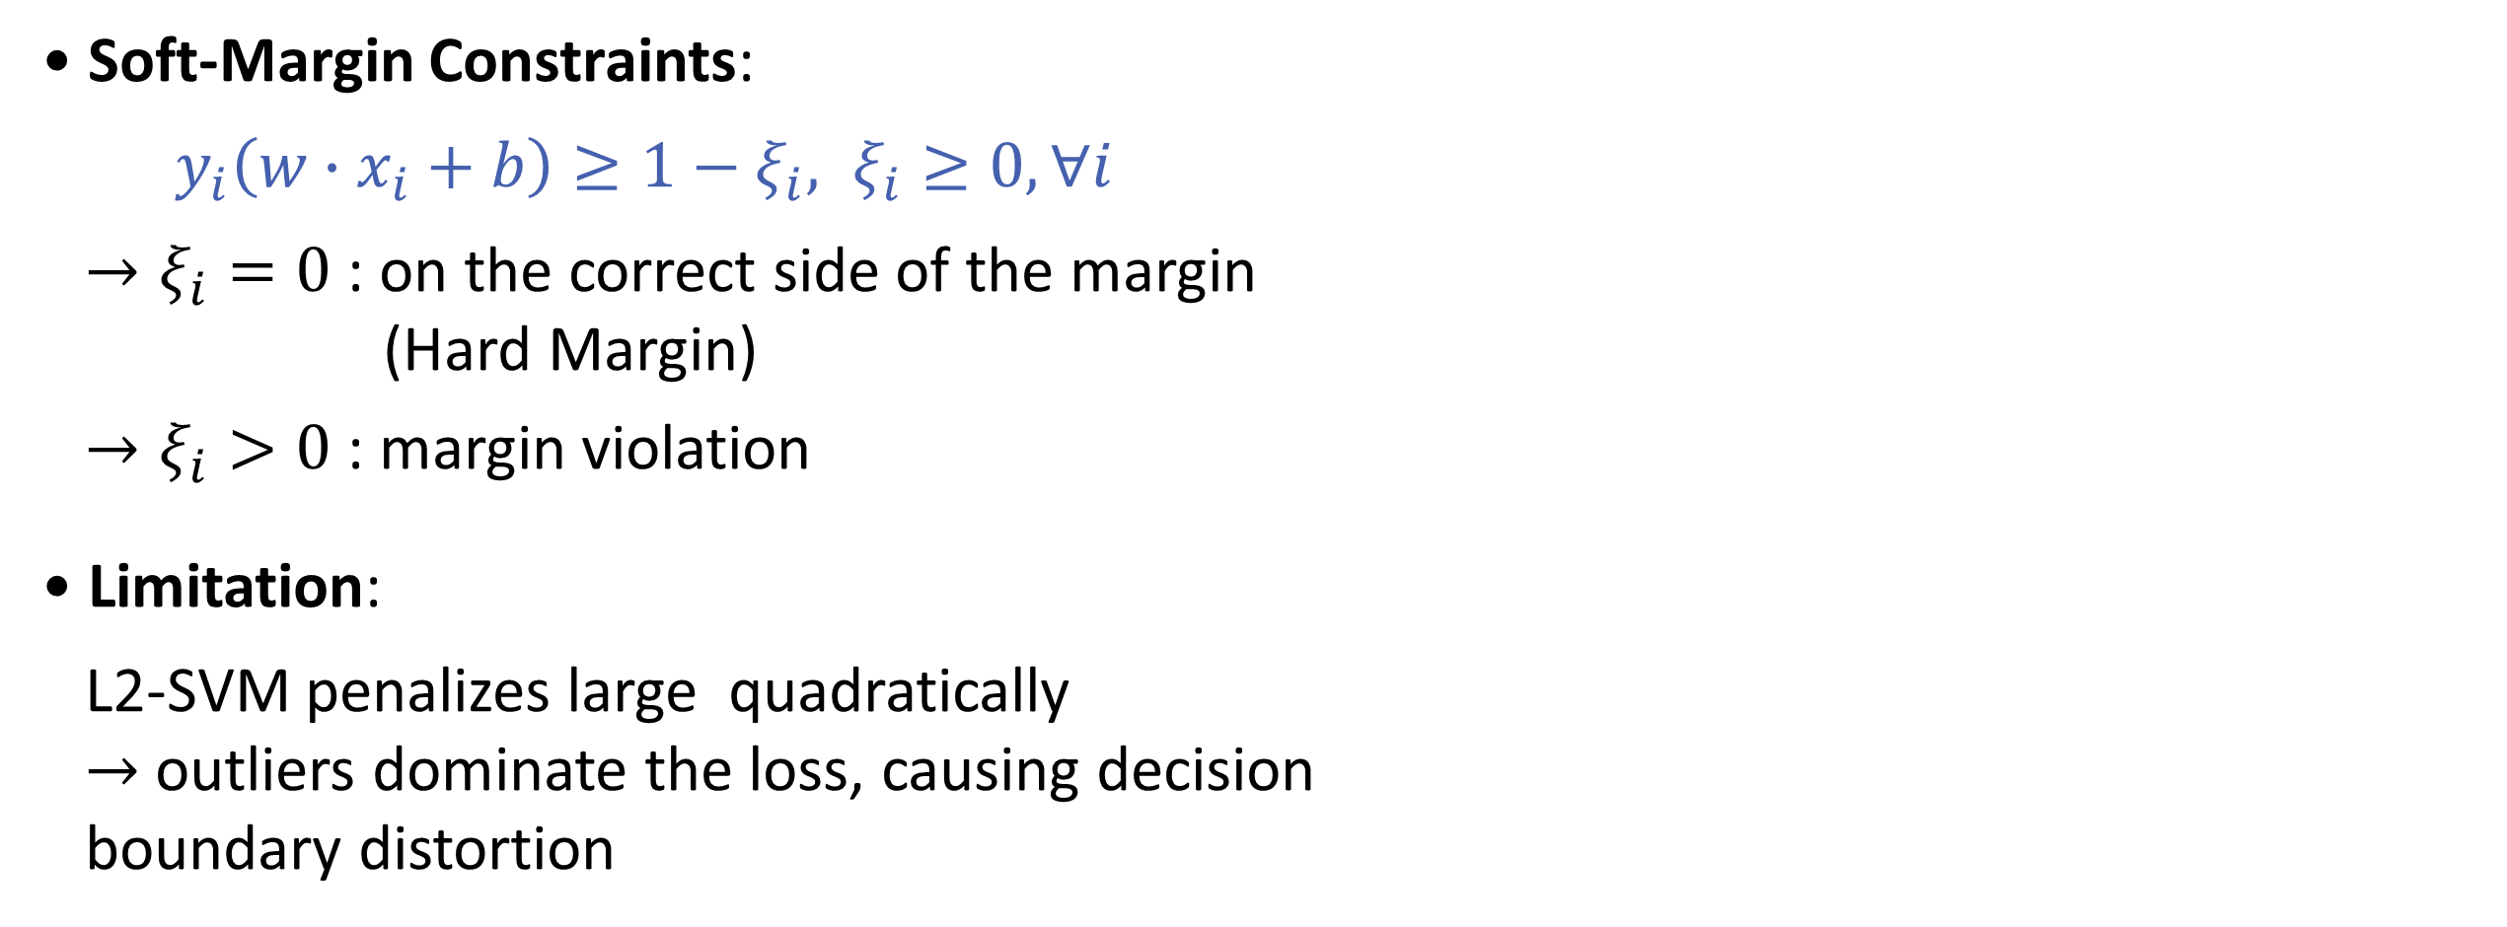
2. Limitations of Traditional SVMs
Role of Slack Variables $ξ_{i}$
• Soft-Margin Constraints:
$y_{i}\left(w∙x_{i}+b\right)≥1−ξ_{i}, ξ_{i}≥0, ∀i$
$→ξ_{i}=0$ : on the correct side of the margin
(Hard Margin)
$→ξ_{i}>0$ : margin violation
• Limitation:
L2-SVM penalizes large quadratically
$→$ outliers dominate the loss, causing decision
boundary distortion
07

Slide 8
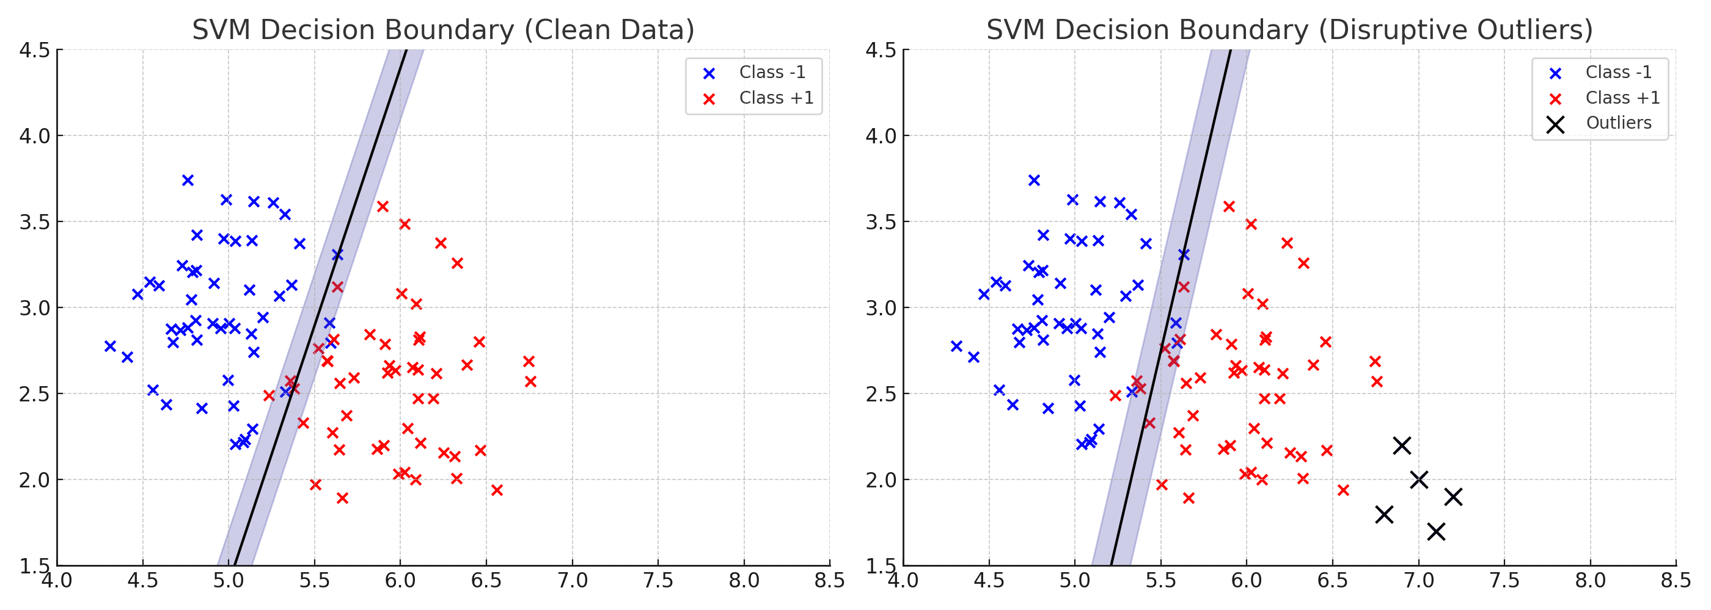
3. Motivation for Robust Methods
08

Slide 9
3. Motivation for Robust Methods
• Traditional SVMs assume that all training data are equally reliable.
• In practice, real-world data often contain noisy labels, measurement error, or outliers.
• L2-SVM heavily penalizes large deviations, causing outliers to dominate the model.
• Robust methods are needed to reduce the influence of extreme errors and learn a more
stable decision boundary.
• M-Estimators offer a flexible way to down-weight the impact of outliers by using
non-quadratic loss functions.
09

Slide 10
3. Limitations of L1-SVMs and L2-SVMs
The Importance for Robustness in SVM
• To address this limitation, our study proposes a framework that integrates M-estimation-
based loss functions.
10

Slide 11
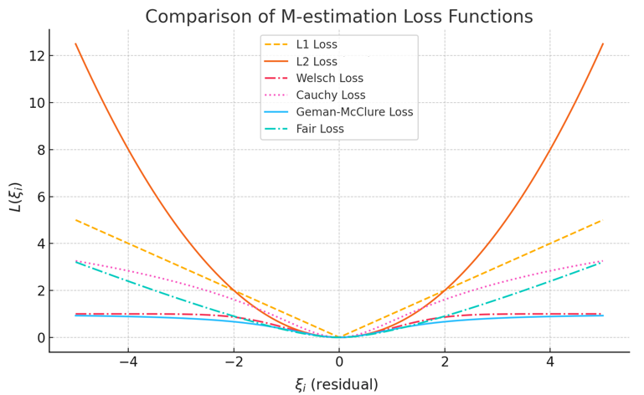
3. Limitations of L1-SVMs and L2-SVMs
The Importance for Robustness in SVM
• Unlike L1 and L2 loss, M-estimation loss suppress the impact of large errors, making the
model more robust to outliers.
11

Slide 12
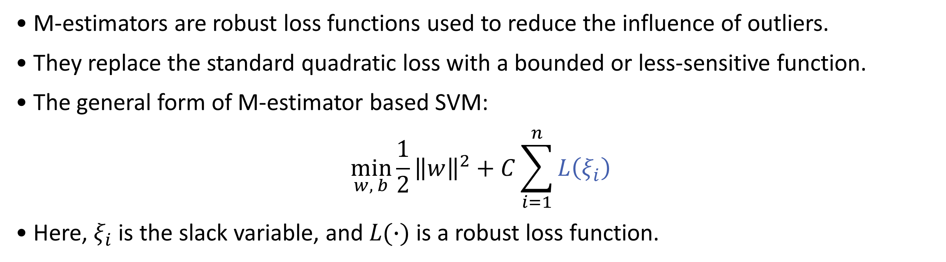
4. M-Estimator-based SVM
• M-estimators are robust loss functions used to reduce the influence of outliers.
• They replace the standard quadratic loss with a bounded or less-sensitive function.
• The general form of M-estimator based SVM:
$$\min_{w, b}\frac{1}{2}{\left\|w\right\|}^{2}+C\sum_{i=1}^{n}{L\left(ξ_{i}\right)}$$
• Here, $ξ_{i}$ is the slack variable, and $L(∙)$ is a robust loss function.
12

Slide 13
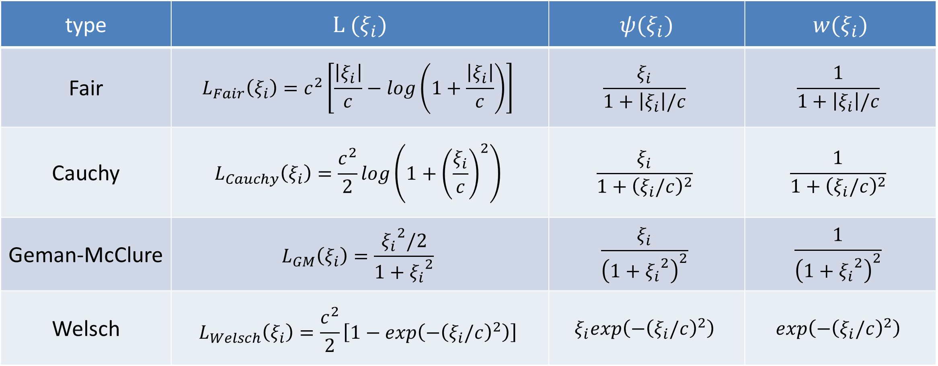
4. M-Estimator-based SVM
Some examples of common functions used in M-Estimators
type | $$L (ξ_{i})$$ | $$ψ(ξ_{i})$$ | $$w(ξ_{i})$$
Fair | $$L_{Fair}\left(ξ_{i}\right)=c^{2}\left[\frac{\left|ξ_{i}\right|}{c}−log\left(1+\frac{\left|ξ_{i}\right|}{c}\right)\right]$$ | $$\frac{ξ_{i}}{1+\left|ξ_{i}\right|/c}$$ | $$\frac{1}{1+\left|ξ_{i}\right|/c}$$
Cauchy | $$L_{Cauchy}\left(ξ_{i}\right)=\frac{c^{2}}{2}log⁡\left(1+{\left(\frac{ξ_{i}}{c}\right)}^{2}\right)$$ | $$\frac{ξ_{i}}{1+{\left(ξ_{i}/c\right)}^{2}}$$ | $$\frac{1}{1+{\left(ξ_{i}/c\right)}^{2}}$$
Geman-McClure | $$L_{GM}\left(ξ_{i}\right)=\frac{{ξ_{i}}^{2}/2}{1+{ξ_{i}}^{2}}$$ | $$\frac{ξ_{i}}{{\left(1+{ξ_{i}}^{2}\right)}^{2}}$$ | $$\frac{1}{{\left(1+{ξ_{i}}^{2}\right)}^{2}}$$
Welsch | $$L_{Welsch}\left(ξ_{i}\right)=\frac{c^{2}}{2}\left[1−exp\left(−{\left(ξ_{i}/c\right)}^{2}\right)\right]$$ | $$ξ_{i}exp\left(−{\left(ξ_{i}/c\right)}^{2}\right)$$ | $$exp\left(−{\left(ξ_{i}/c\right)}^{2}\right)$$
13

Slide 14
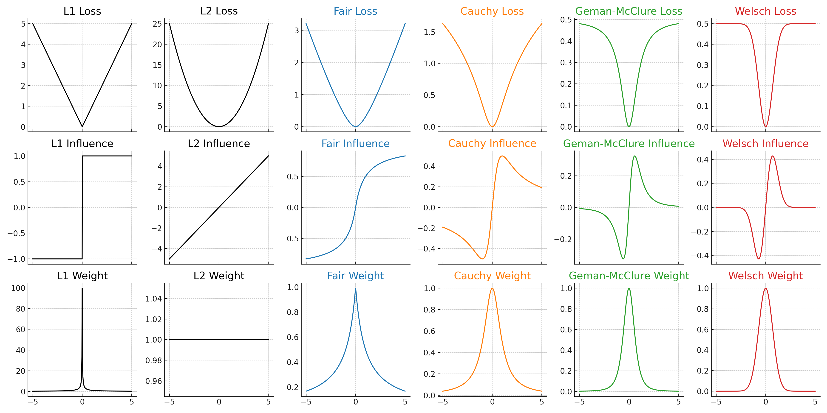
4. M-Estimator-based SVM
14

Slide 15
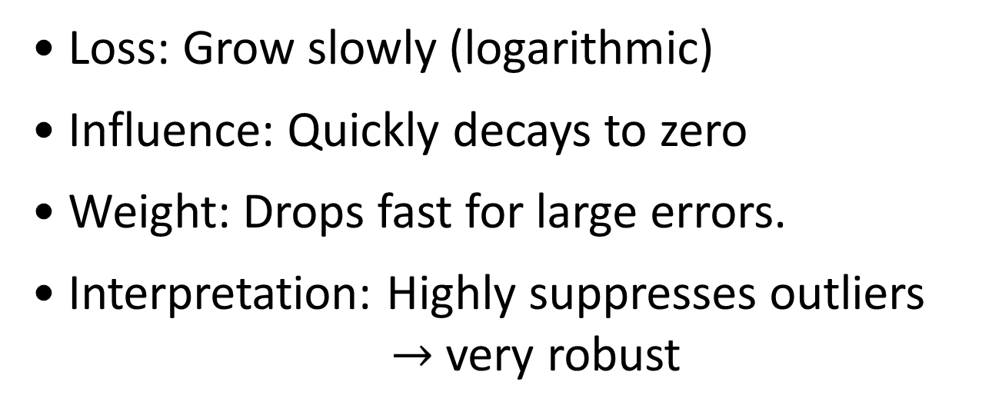
4. M-Estimator-based SVM
Type Fair SVM
Type Cauchy SVM
• Loss: Smoothly increases, grows slower.
• Influence: Linear near zero,
but saturates for large residuals.
• Weight: Decreases slowly in large residuals.
• Interpretation: Suppresses large errors,
sensitive to small ones.
• Loss: Grow slowly (logarithmic)
• Influence: Quickly decays to zero
• Weight: Drops fast for large errors.
• Interpretation: Highly suppresses outliers
$→$ very robust
15

Slide 16
4. M-Estimator-based SVM
Type Geman-McClure SVM
Type Welsch SVM
• Loss: Quadratic initially, then bounded
• Influence: Strong near zero, fades quickly
• Weight: Steep decline with residual
• Interpretation: Suppresses large errors,
limits outlier impact.
• Loss: Smooth and bounded,
flattens for large errors
• Influence: Sensitive only to moderate error
• Weight: Peaks at zero, fades rapidly
• Interpretation: Ignores outliers and
tiny noise, targets mid-level errors
16

Slide 17
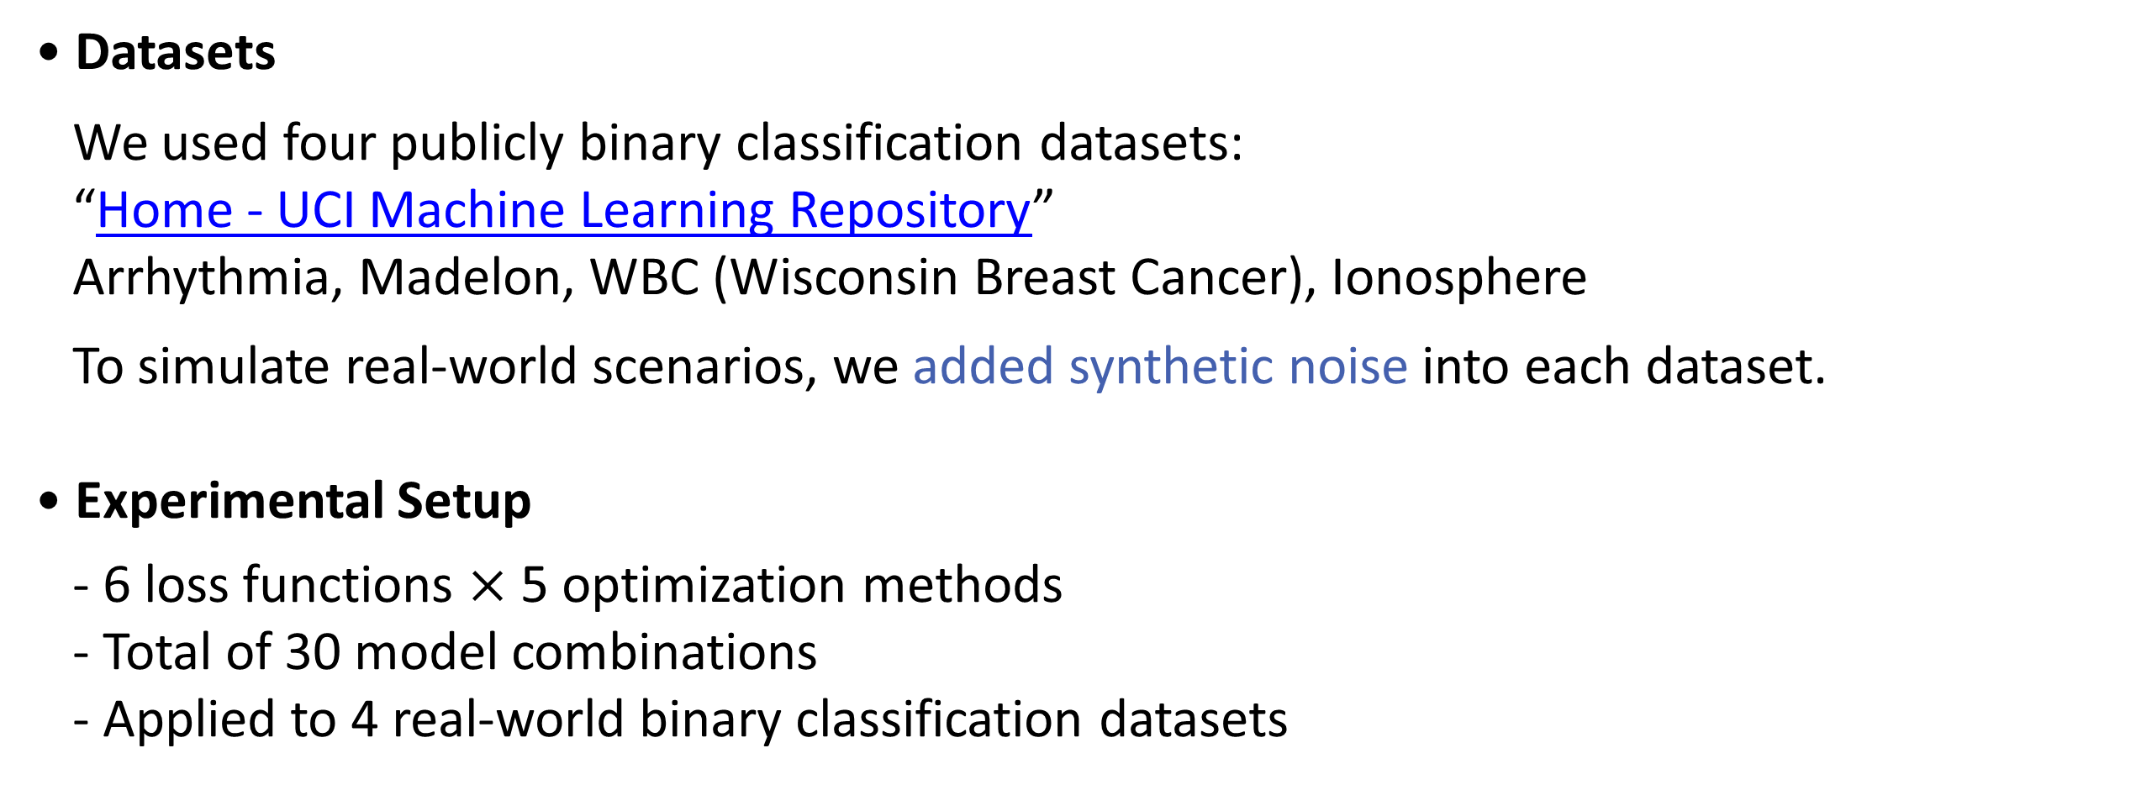
5. Data Analysis
• Datasets
We used four publicly binary classification datasets:
“Home - UCI Machine Learning Repository”
Arrhythmia, Madelon, WBC (Wisconsin Breast Cancer), Ionosphere
To simulate real-world scenarios, we added synthetic noise into each dataset.
• Experimental Setup
- 6 loss functions $×$ 5 optimization methods
- Total of 30 model combinations
- Applied to 4 real-world binary classification datasets
17

Slide 18
5. Data Analysis
Optimization Methods Used:
• SMO (Sequential Minimal Optimization)
Traditional method for solving SVM’s quadratic problem efficiently.
• GA (Genetic Algorithm)
Evolutionary algorithm inspired by natural selection.
• PSO (Particle Swarm Optimization)
Population-based method inspired by the movement of bird flocks.
• ACO (Ant Colony Optimization)
Mimics ant foraging behavior to find optimal paths.
• HS (Harmony Search)
Inspired by musical improvisation, aiming to find a pleasing harmony (solution).
18
Notes:
이번 실험에서는 총 5개의 최적화 알고리즘을 사용했습니다. SMO는 SVM의 전통적인 최적화 방법으로 널리 쓰이는 반면, GA, PSO, ACO, HS는 각각 진화나 집단 기반 탐색 원리에 기반한 글로벌 최적화 기법입니다. 특히 PSO나 ACO 같은 알고리즘은 비선형, 비볼록 최적화 문제에 효과적이며, 다양한 손실함수에 적용 가능하다는 장점이 있습니다.

Slide 19
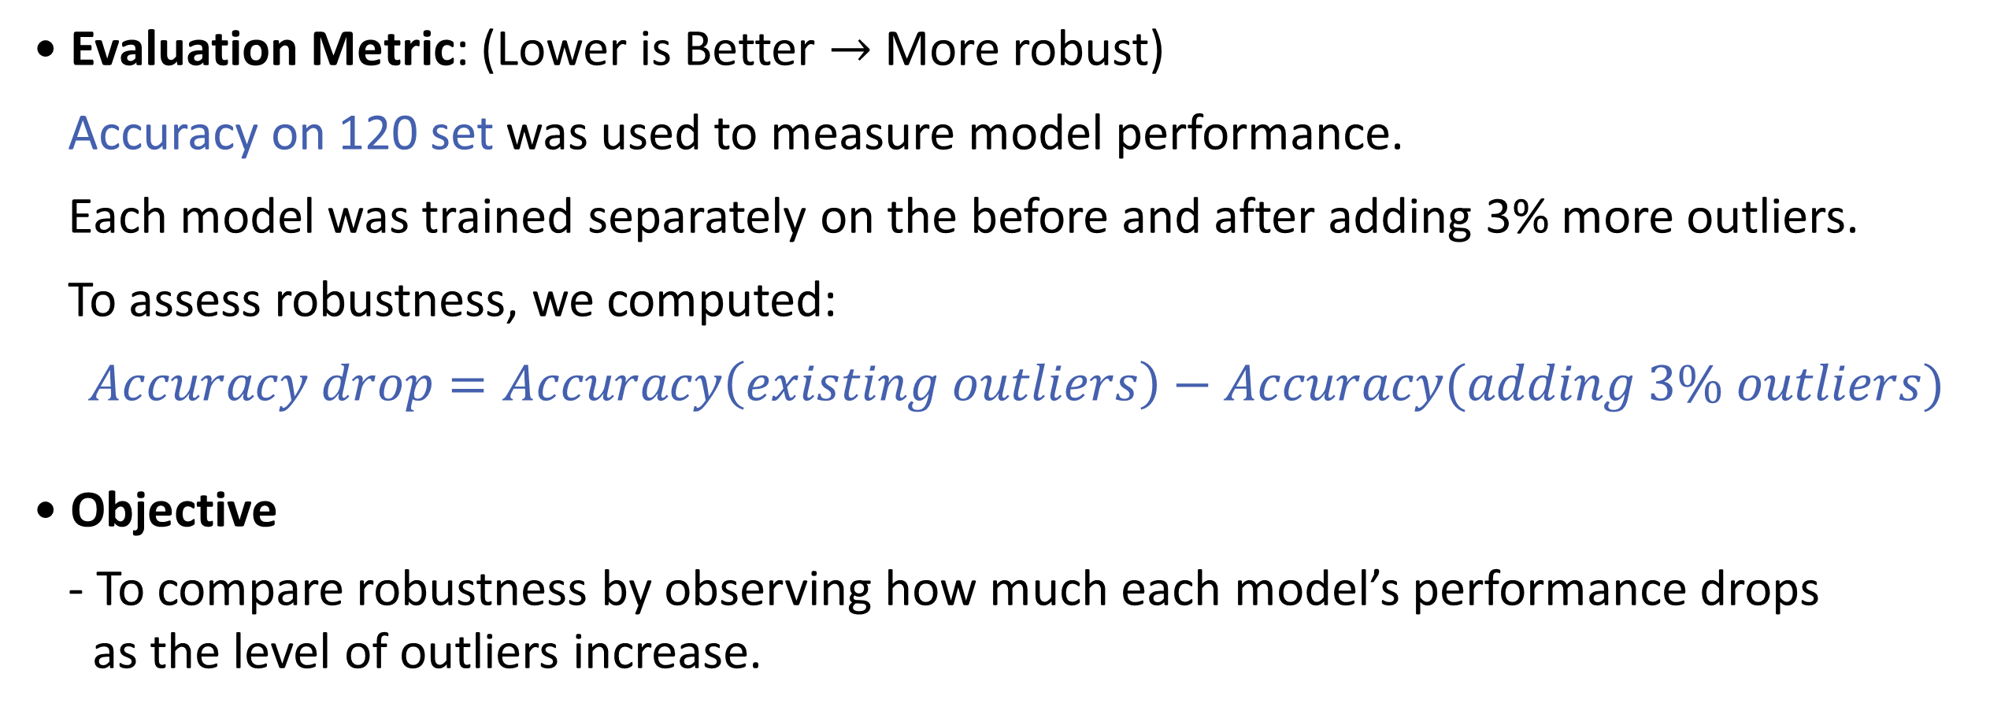
5. Data Analysis
• Evaluation Metric: (Lower is Better $→$ More robust)
Accuracy on 120 set was used to measure model performance.
Each model was trained separately on the before and after adding 3% more outliers.
To assess robustness, we computed:
$$Accuracy drop=Accuracy\left(existing outliers\right)−Accuracy(adding 3\% outliers)$$
• Objective
- To compare robustness by observing how much each model’s performance drops
as the level of outliers increase.
19

Slide 20
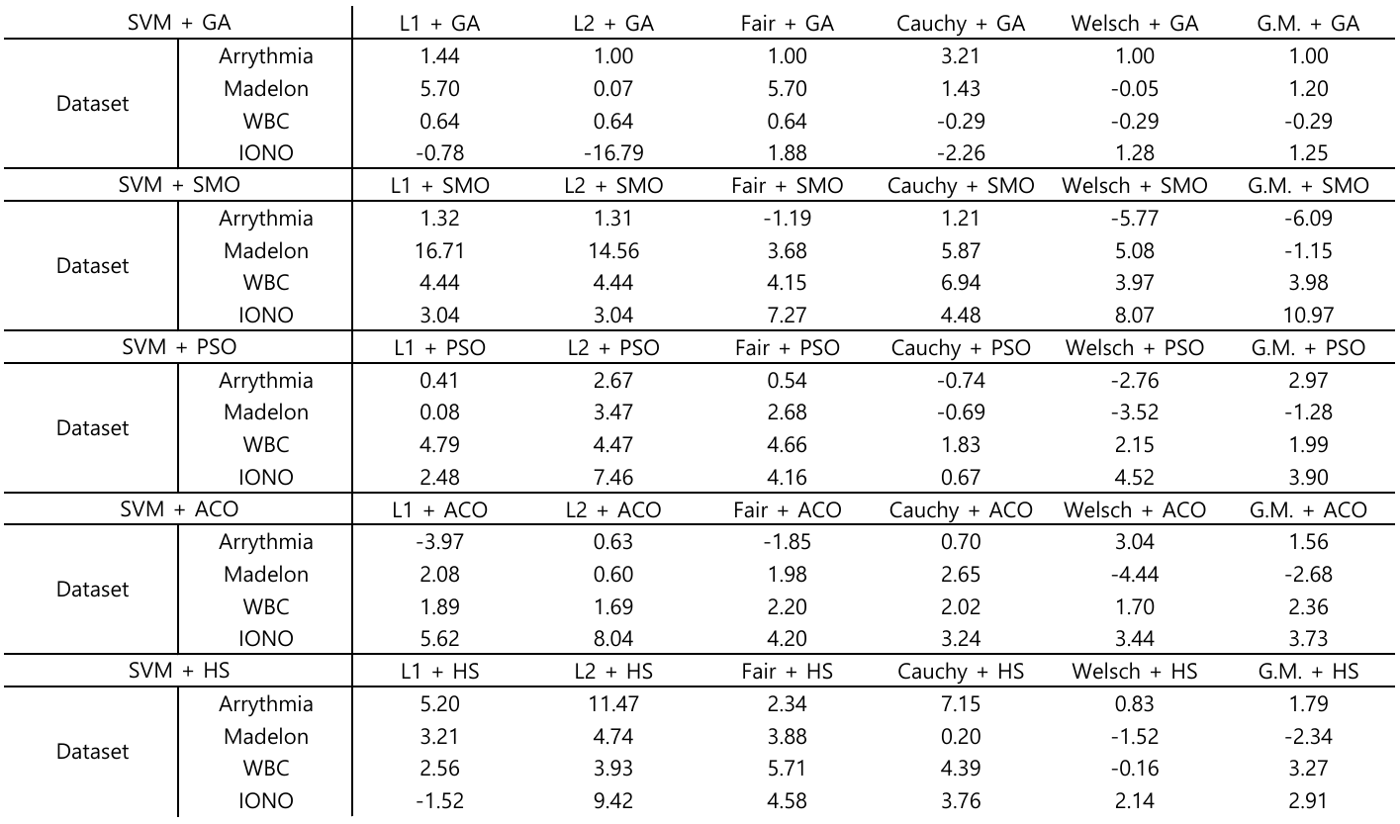
5. Data Analysis
20

Slide 21
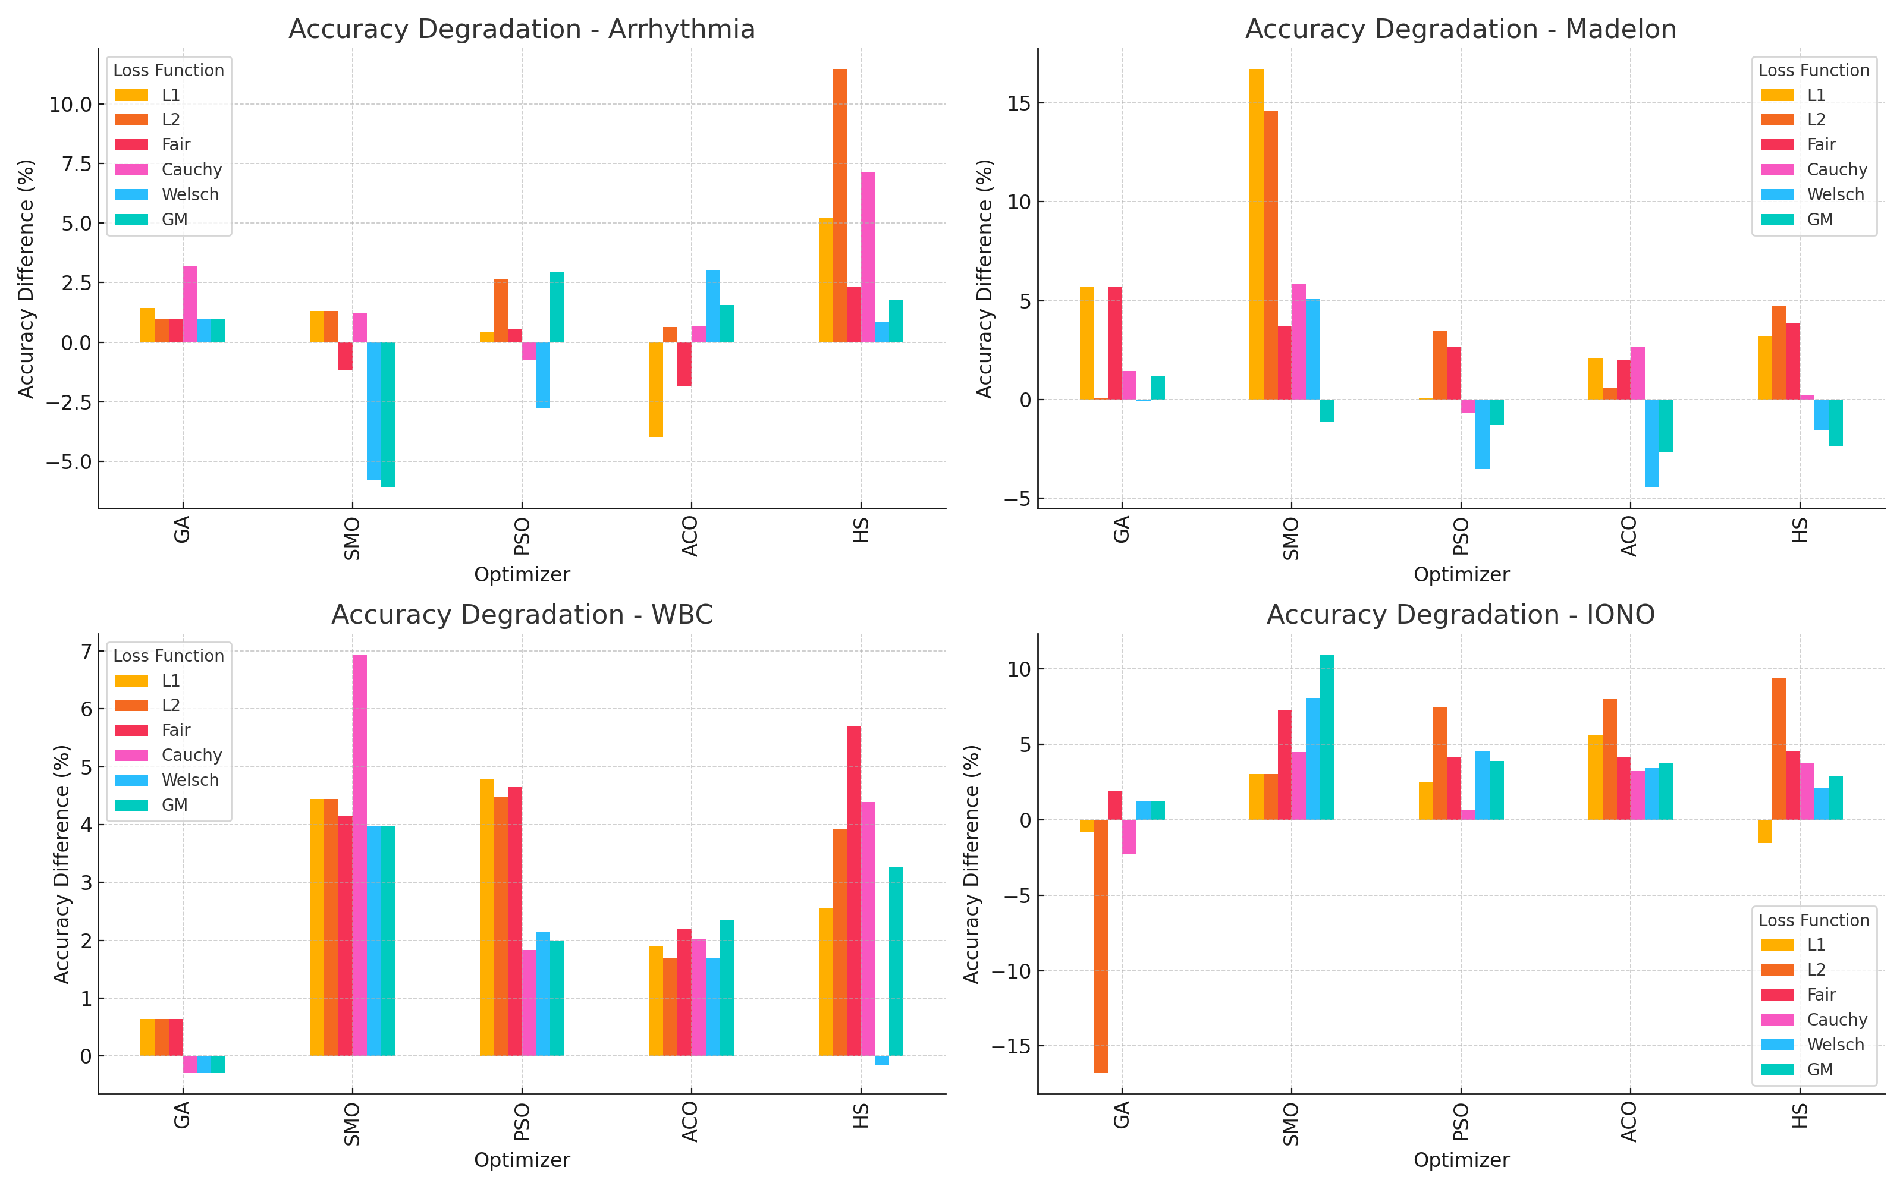
5. Data Analysis
21

Slide 22
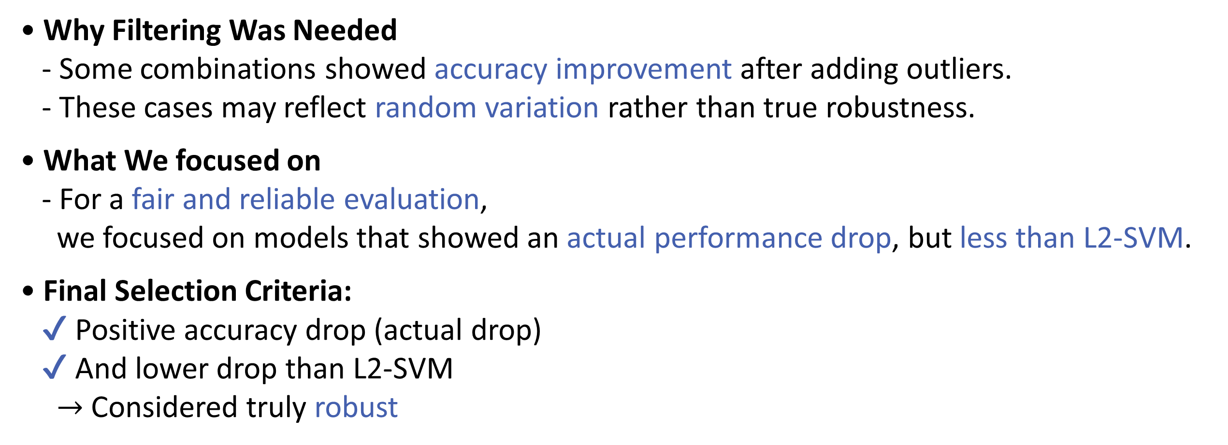
5. Data Analysis
• Why Filtering Was Needed
- Some combinations showed accuracy improvement after adding outliers.
- These cases may reflect random variation rather than true robustness.
• What We focused on
- For a fair and reliable evaluation,
we focused on models that showed an actual performance drop, but less than L2-SVM.
• Final Selection Criteria:
✔ Positive accuracy drop (actual drop)
✔ And lower drop than L2-SVM
$→$ Considered truly robust
22

Slide 23
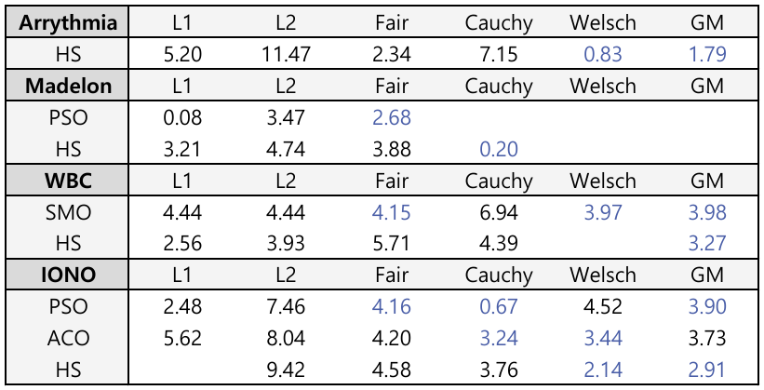
5. Data Analysis
23

Slide 24
6. Conclusion
• SVM’s Limitation
- Support Vector Machines (SVMs) are powerful classifiers,
but they are vulnerable to outliers.
• Our approach
- We introduced M-estimation-based loss functions to improve the robustness of SVMs.
- Conducted experiments with:
✔ 6 loss functions
✔ 5 optimization algorithms
✔ 4 real-world datasets
✔ Varying levels of synthetic outliers
24

Slide 25
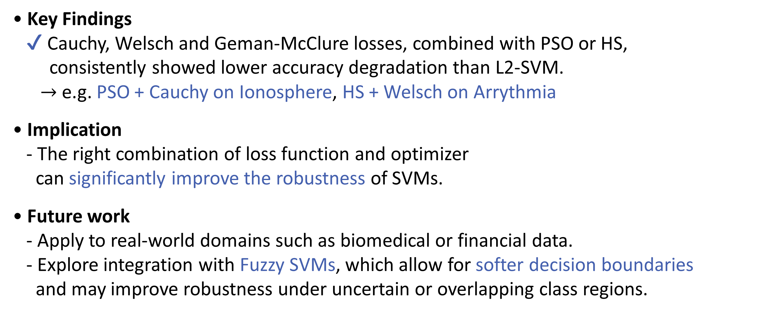
6. Conclusion
• Key Findings
✔ Cauchy, Welsch and Geman-McClure losses, combined with PSO or HS,
consistently showed lower accuracy degradation than L2-SVM.
$→$ e.g. PSO + Cauchy on Ionosphere, HS + Welsch on Arrythmia
• Implication
- The right combination of loss function and optimizer
can significantly improve the robustness of SVMs.
• Future work
- Apply to real-world domains such as biomedical or financial data.
- Explore integration with Fuzzy SVMs, which allow for softer decision boundaries
and may improve robustness under uncertain or overlapping class regions.
25

Slide 26




Thank You
한국지능시스템학회 2025 춘계학술대회

